Slide 1
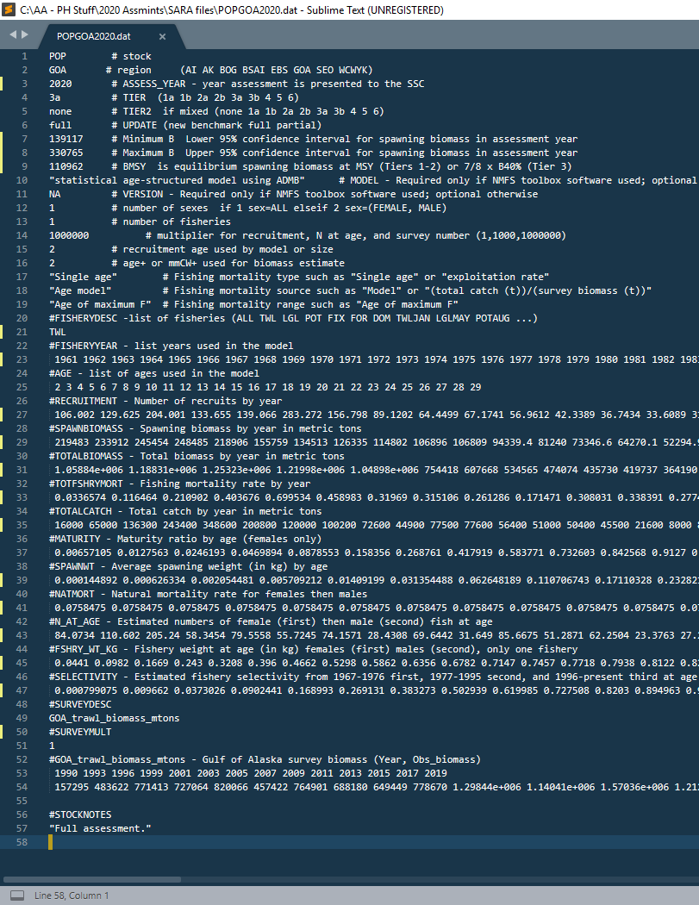
Shouldn’t need to change these ones, but double check you’re in the right region and stock
Change to current year
Double check tier level, have only had issue with northerns at 3b in past
This will always be ‘none’
Write in the type of assessment:
‘new’ would happen if we change tier levels from 5 to 3
‘benchmark’ means substantial changes have been made to assessment
‘full’ is normally what we do in ‘on’ year
‘partial’ is for exec summary in ‘off’ year

Slide 2
These come from the ‘2.5%’ and ‘97.5%’ columns in your MCMC table (9-17 for POP, 10-15 for northerns, 12-15 for duskys, 13-19 for REBS), note: in ‘off’ year use the table values from the previous ‘on’ year assessment
Compute this as directed (7/8 x B40%)
Unless we change to SS or TMB at some point, this won’t change
This will always be ‘NA’
As documented, number of sexes, will be ‘1’ unless we change in future
This is the number of fisheries you are modeling, so, for example (REBS is a good case), if they’re caught by trawl and LL gear, but you combine the fishery age/length comp for modeling, this is ‘1’, if you model the gear types separately, this would be ‘2’

Slide 3
Multiplier, won’t change
‘2’ for POP & northerns, ‘4’ for duskys, ‘3’ for REBS
What is the youngest age included for estimating biomass, for us it’s recruitment age (for SS recruitment may be 0 but this could be an older age)
‘Single age’ for us
We estimate annual F and F at age thru selex, so ‘Age model’ here, herring, for example, would be computed and not estimated
We just stuck in example here

Slide 4
We’ve always had ‘ALL’ here, but would prolly be more appropriate to have ‘TWL’ for POP, northerns, and duskys, but have ‘ALL’ for REBS
Years in model
Modeled ages (not data ages)
Recruitment, biomass, & F estimates, easiest place to get this is from .rep file – for POP I have ‘SpBiom’, ‘Tot_biom’, ‘Recruitment’, and ‘Fully_selected_F’ reported out so I can grab these easily
Observed catch
Maturity estimates, easiest place to grab this is from the proj.dat file

Slide 5
This one is calculated as:
0.5*w*m/1000
Where w is weight-at-age (in g, from .dat file), m is maturity (previous line here)
M across ages, easiest place to get this is in proj.dat file
Numbers at age in final year of model, easiest place to get this is from proj.dat file
This is just w/1000 where w is weight-at-age in g from .dat file
Fishery selex, if time-dependent then use from most recent year
Survey index description, won’t need to change this

Slide 6
Survey multiplier, won’t need to change this one
Year and survey index, for the moment I’m not aware of needing to include some measure of variance
Additional notes, if you did a benchmark assessment, this is where you’d provide brief description of what was done

